Slide 1
Longleaf
Figuring out mortality (simulations run for 80 years do not show characteristic decreasing frequency with increasing size class)
I used new mortality from Platt 1988 (U-shaped, but with steeper curve)

Slide 2
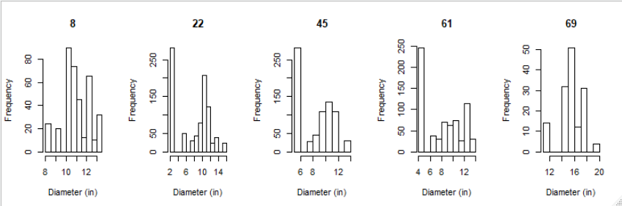
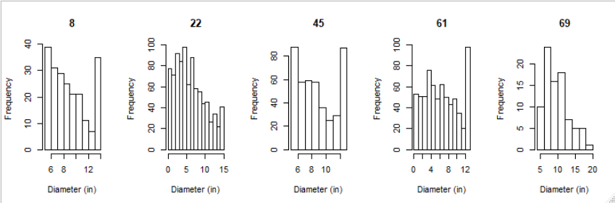
Observed vs modeled diameter distributions
Observed
Modeled

Slide 3
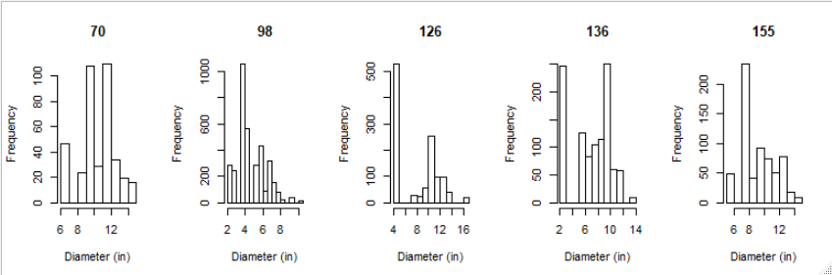
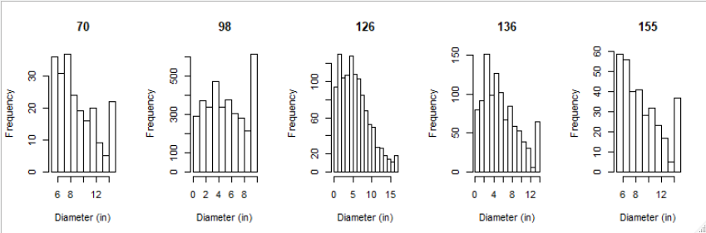
Observed vs modeled diameter distributions

Slide 4
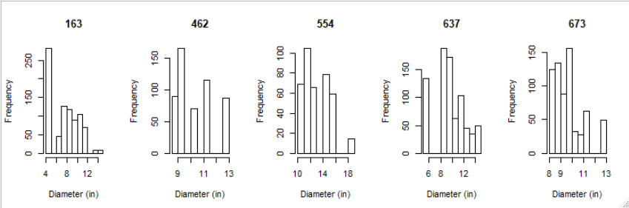
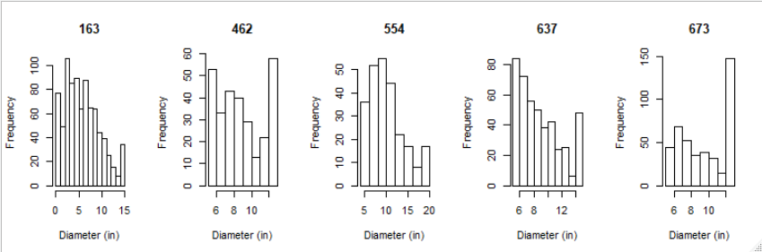
Observed vs modeled diameter distributions

Slide 5
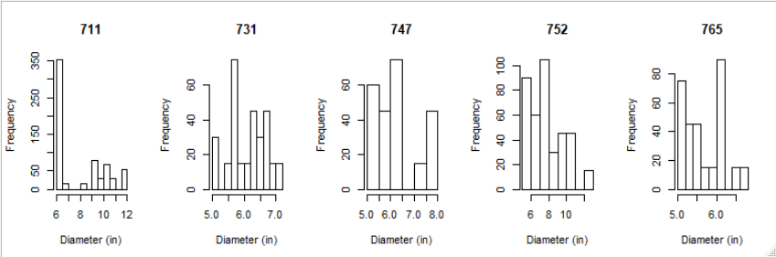
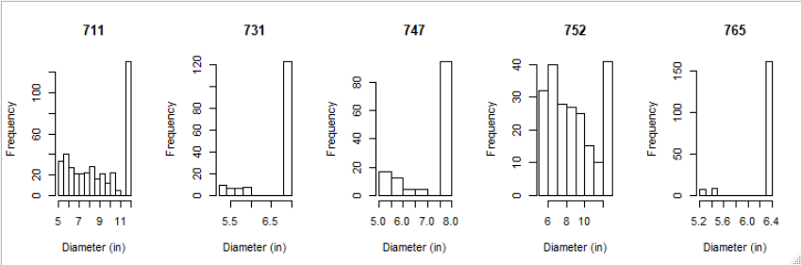
Observed vs modeled diameter distributions

Slide 6
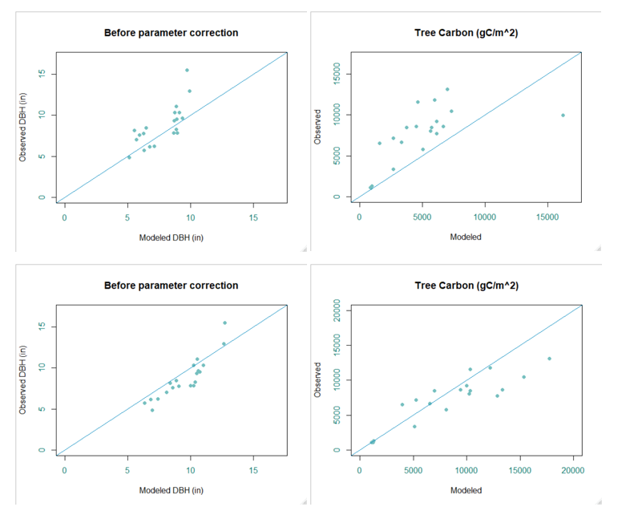
Top is new, steeper mortality curve (Platt 1988). Bottom is old mortality curve

Slide 7
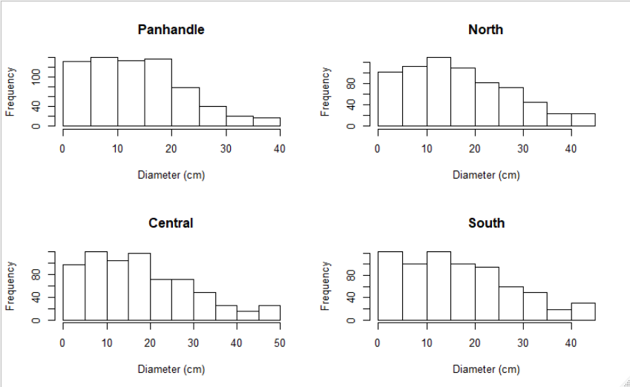
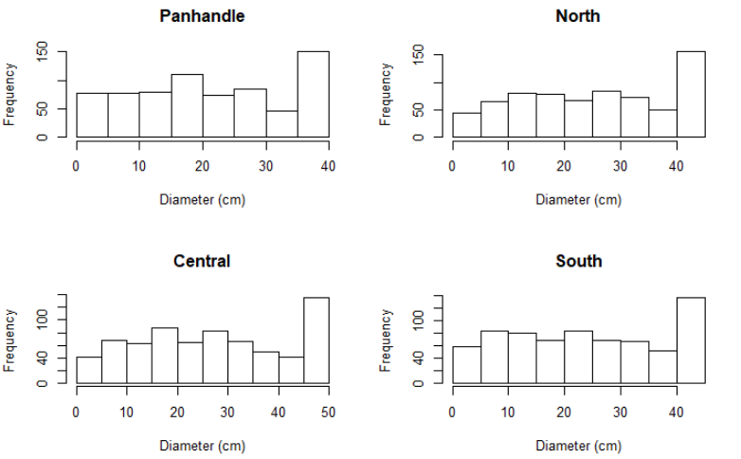
Left is 700tph simulated for 80 years using new mortality compared to old mortality (right)

Slide 8
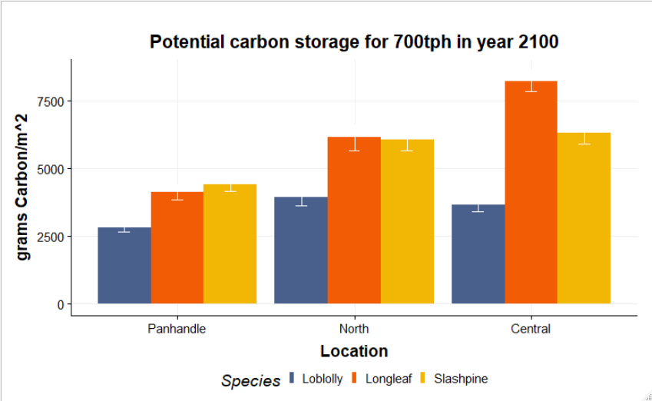
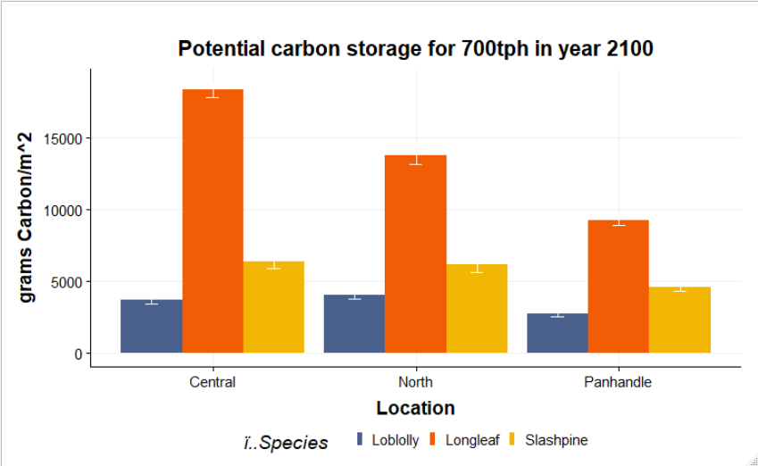
Graph on left is with new longleaf mortality

